Slide 1
Introduction to Submodular Functions and Applications lecture-15 Course on Graph Neural Networks (Winter Term 20/21)
Christian Medeiros Adriano (christian.adriano@hpi.de) - “Chris”
Sona Ghahremani (sona.ghahremani@hpi.de )
Prof. Dr. Holger Giese (holger.giese@hpi.de)

Slide 2
How do we build theories?
Iteratively
Dominic Welsh 1976
"…mathematical generalization often lays bare the important bits of information about the problem at hand
Problem solving
Problem thinking
Which methods and tools can we apply to solve this problem?
What is the structure that would help us solve more of these problems?
Structure = Submodularity
Solution = greedy methods

Slide 3
Discrete Optimization [Vondrak 2014]
Discrete or Combinatorial Optimization
“Discrete” because the choices are discrete, for instance, we do not take a fraction of a node or edge.
Maximize or Minimize an objective function F(S)
https://youtu.be/Y3u_hvxayDY?t=1860
Vondrak, J., (2012), Submodular Functions and Their Applications, Discrete Math Conference, https://theory.stanford.edu/~jvondrak/data/SIDMA-plenary-talk.pdf
Notes:
Finding a solution S in some finite set of feasible solution F
Discrete is more difficult than continuous
Hence, on solution approach is to transform a discrete optimization into a continuous one
As with continuous optimization, discrete also encompasses convex and concave functions

Slide 4
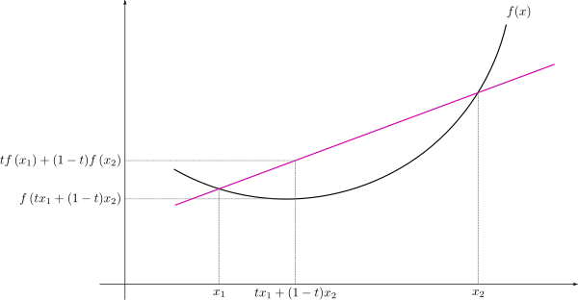
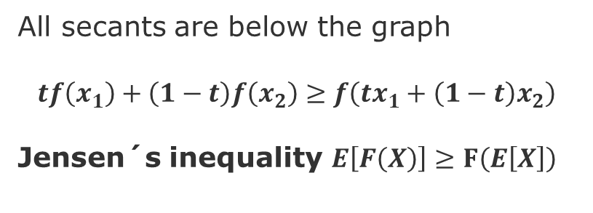
Convex, Concave, and Non-Convex functions
Convex
Concave
Non-Convex
secant
Wikipedia
All secants are below the graph
$$tf\left(x_{1}\right)+\left(1−t\right)f\left(x_{2}\right)≥f\left(tx_{1}+\left(1−t\right)x_{2}\right)$$
Jensen´s inequality $E\left[F\left(X\right)\right]≥F\left(E\left[X\right]\right)$
All secants are a above the graph
Yurii Nesterov (2004). Introductory Lectures on Convex Optimization: A Basic Course.
Dimitri Bertsekas (2003). Convex Analysis and Optimization. Contributors: Angelia Nedic and Asuman E. Ozdaglar. Athena Scientific.
Notes:
Sources:
Yurii Nesterov (2004). Introductory Lectures on Convex Optimization: A Basic Course. Kluwer Academic Publishers. pp. 63–64
Dimitri Bertsekas (2003). Convex Analysis and Optimization. Contributors: Angelia Nedic and Asuman E. Ozdaglar. Athena Scientific. p. 72. ISBN 9781886529458.

Slide 5
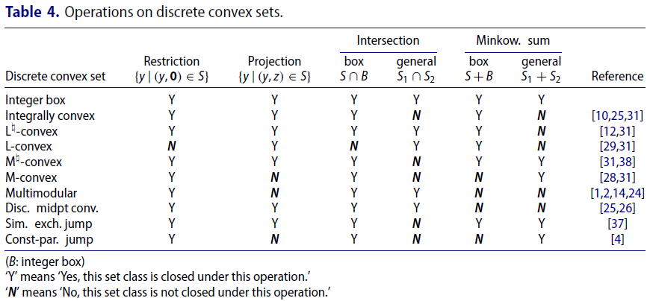
Convex functions four properties [Lovasz 1983]
1. They happen in may models of the world
Economy
Engineering
Sciences
2. They are preserved after many operations and transformations, hence Hnce more complex models and results can be derived from simpler. Same with proofs.
Shift, Restriction, Projection, Intersection, Sum
3. They have a sufficient structure for “mathematical
Lovász, L. (1983) "Submodular functions and convexity." Mathematical programming the state of the art. Springer, Berlin, Heidelberg. 235-257.
Murota, K. (2019). A survey of fundamental operations on discrete convex functions of various kinds. Optimization Methods and Software, 1-47.
Notes:
Lovász, László. "Submodular functions and convexity." Mathematical programming the state of the art. Springer, Berlin, Heidelberg, 1983. 235-257.

Slide 6
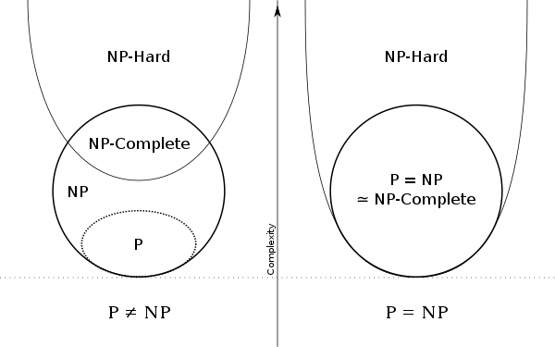

Example of Combinatorial Optimization Problems
B
5
Graph cut problems
Graph cut defines two disjoint subsets of nodes and the weight of the cut is defined to be equal to the sum of the weights of edges that connect the disjoint subsets.
Min Cut minimum if the weight of the cut is not larger than the size of any other cut. Polynomial.
Max Cut maximum if the weight of the cut is not smaller than the size of any other cut. NP-Complete
Sparsest cut bipartition the vertices that minimize the ratio of the number of edges across the cut divided by the number of vertices in the smaller half of the partition NP-hard
Wikipedia
C
5
15
A
5
5
F
C
5
10
E
5
Computational Complexity
P: $X ∈P$ if it has an algorithm whose complexity is a polynomial function of its inputs
NP: (Non-deterministic polynomial) $X ∈NP$ if there’s a polynomial-time algorithm to check a solution, but not to find one.
NP-Complete: $X ∈NP Complete$ if it is possible to reduce X to another NP problem $Y$ in polynomial-time.
NP-Hard: – $X ∈NP Hard$ if there’s an NP-complete problem $Y$ that is reducible to $X$ in polynomial time
[Cormen et al. 2015]
Matching problems
Maximal matching, Perfect matching
String matching find where several strings are found within a larger string or text.
Graph traversal problems
Minimum Spanning Tree
Traveling Salesman
B
5
C
B
C
5
15
A
5
5
F
A
F
10
C
E
5
C
E
5
Notes:
Examples of discrete optimization problems are spanning trees, matchings, graph cuts, traveling salesman, knapsack, minimum clique, vertex cover, set Cover.
Some problems are in P:
Min Spanning Tree, Max Flow, Min Cut, Max Matching,...
Many problems are NP-hard:
Traveling Salesman, Max Clique, Max Cut, Set Cover, Knapsack
Graph cut algorithms:
Minimum Cut –Edmonds-Karp Algorithm [1]
Maximum Cut – It an be approximated to within a constant ratio using semidefinite programming [2]
Sparsest Cut – It can be approximated using Arora, Rao & Vazirani [3] with a complexity O((log n)^1/2) [3]
[1] Cormen, Thomas H.; Leiserson, Charles E.; Rivest, Ronald L.; Stein, Clifford (2001), Introduction to Algorithms (2nd ed.), MIT Press and McGraw-Hill, p. 563,655,1043, ISBN 0-262-03293-7.
[2] Goemans, M. X.; Williamson, D. P. (1995), "Improved approximation algorithms for maximum cut and satisfiability problems using semidefinite programming", Journal of the ACM, 42 (6): 1115–1145, doi:10.1145/227683.227684.
[3] Arora, Sanjeev; Rao, Satish; Vazirani, Umesh (2009), "Expander flows, geometric embeddings and graph partitioning", J. ACM, ACM, 56 (2): 1–37, doi:10.1145/1502793.1502794.
Computational Complexity
P – Complexity is a Polynomial function of the inputs
NP – (Non-deterministic polynomial) X is NP if has polynomial-time solution checking, but non-Polynomial time solution finding
NP-Complete – X is NP-Complete if it is possible to reduce X to another NP problem Y in polynomial time.
NP-Hard – X is NP-Hard if there is an NP-complete problem Y that is reducible to X in polynomial time
Nice summary here:
https://stackoverflow.com/questions/1857244/what-are-the-differences-between-np-np-complete-and-np-hard

Slide 8
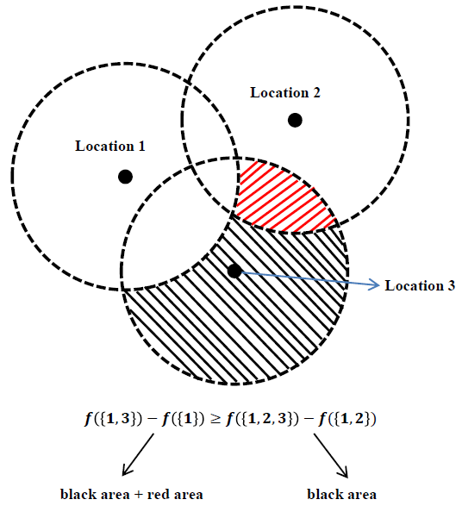
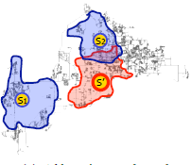
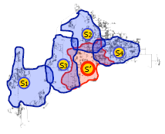
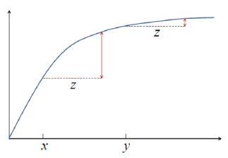
The Phenomenon of Diminishing Returns
[Krause & Golovin 2014]
[Liu et al. 2020]
Adding s’ to
set A = {s1, s2}
B
Adding s’ to
set B = {s1, s2,s3,s4}
A
Diminishing returns means that adding the same sensor to superset of A would provide an equal or lower marginal gain than adding to set A.
i.e., “the more I know the less I gain from acquiring more items to the set”
The marginal gain can be:
Cost/loss (of picking a combination of items)
Probability (of contagion or protection)
Utility (of matching services and clients)
Krause, A. , Golovin, D., (2014), Submodular Function Maximization
Liu, Y., et al., (2020), Submodular optimization problems and greedy strategies: A survey. Discrete Event Dynamic Systems: 1-32.
Notes:
The problem of maximizing a monotone submodular function subject to a cardinality constraint admits a 1 − 1 / e approximation algorithm
Krause, A. , Golovin, D., 2014, Submodular Function Maximization.

Slide 9
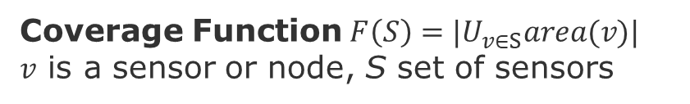
Phenomena with Diminishing returns
Maximization problems
Information gathering, F(S) = Information
Sensor placing, Monitoring, Testing
Summarization, F(S) = Representation
Image recognition, Dictionary learning
Influence maximization, F(S) = Spread
Contagion, Behavior/Technology adoption
Coverage Function$F\left(S\right)=|U_{v∈S}area(v)|$
$v$ is a sensor or node, S set of sensors
V
V
Z
W
Z
X
W
Y
Y
S
S’
$$F\left(S U v\right)−F\left(S\right)≥F\left(S′ U v\right)−F\left(S′\right)$$
B
C
Diffusion in networks is a stochastic version of coverage
Minimization problems
Semi-supervised learning
Clustering, F(S) = separation
Labeling, F(S) = matching
Dimensionality reduction
Denoising, F(S) = coherence
A
F
C
E
These problems can be efficiently solved by a particular class of submodular functions called poly-matroids and greedy algorithms.
Notes:
Spread is a stochastic version of coverage submodular function.

Slide 10
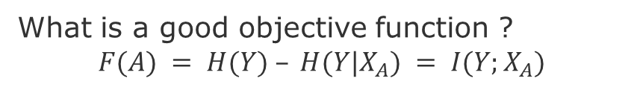
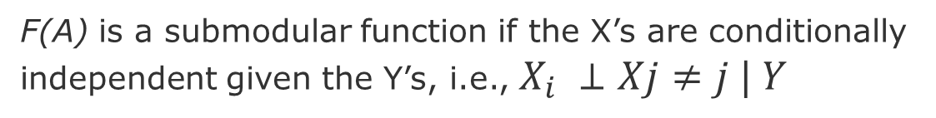
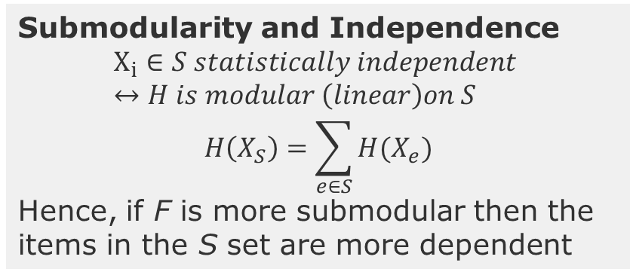
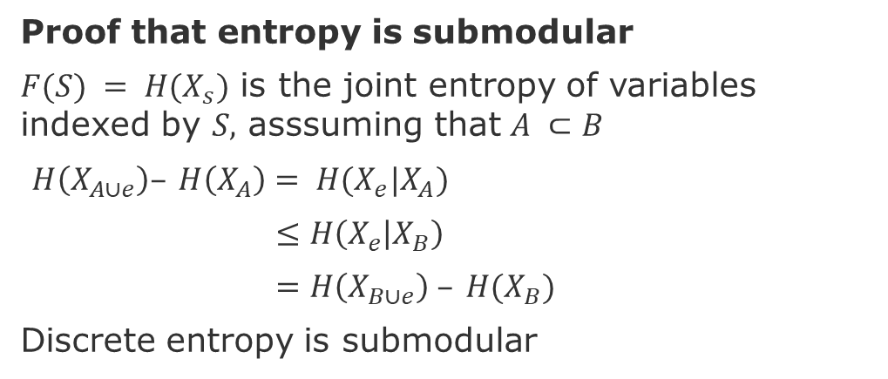
Sensing problem - Entropy
Y₁
Y₄
Proof that entropy is submodular
$F(S) = H(X_{s})$ is the joint entropy of variables indexed by $S,$ asssuming that $A ⊂B$
$H\left(X_{A∪e}\right)– H\left(X_{A}\right)= H(X_{e}|X_{A})$
$≤H\left(X_{e} | X_{B}\right)$
$=H\left(X_{B∪e}\right) – H(X_{B})$
Discrete entropy is submodular
Y₂
Y₃
X₄
X₁
X₂
X₃
information never hurts
Goal: How to reduce the uncertainty about hidden variables Y_{i} given the observed ones X_{i}
What is a good objective function ?
$$F(A) = H(Y) – H(Y|X_{A}) = I(Y;X_{A})$$
Submodularity and Independence
$$X_{i}∈S statistically independent ↔H is modular \left(linear\right)on S$$
$$H\left(X_{S}\right)=\sum_{e∈S}{H(X_{e})}$$
Hence, if F is more submodular then the items in the S set are more dependent
Utility of having sensors in location A
Uncertainty about temperature Y before sensor reading
Uncertainty about temperature Y after sensor reading
Mutual Information between hidden and observed variables
F(A) is a submodular function if the X’s are conditionally independent given the Y’s, i.e., $X_{i} ⊥Xj≠j | Y$
Liu et al.(2020) Submodular optimization problems and greedy strategies
Jegelka, S., (2017), Submodularity: Theory and Applications I - https://www.youtube.com/watch?v=Y3u_hvxayDY
Notes:
Knowing more only shrinks entropy
F(A) is a submodular function if the Xs are conditionally independent given the Ys
Sub-additive when variables are independent, then we have the strict modularity with the equality
What is a good ob. Func.
Select x to learn about y?
How much I reduce my uncertain as I select Xs?

Slide 11
Adaptive Sensing – Adaptive Submodularity
We note a commonly used
metric, reduction of Shannon entropy, is submodular under
certain assumptions, rendering the greedy solution comparable
to the optimal plan in the offline setting. However, reacting
online to observations can increase performance. Recently
developed notions of adaptive submodularity provide guarantees for a greedy algorithm in this online setting.
Zhang, Y. et al., (2016), String submodular functions with curvature constraints
Liu, Y. et al.(2018), Performance bounds with curvature for batched greedy optimization.
Notes:
References:
Liu, Y., Z. Zhang, E. K. P. Chong, and A. Pezeshki, 2018d: Performance bounds with curvature for batched greedy optimization. J Optim Theory
Appl, 177, 535-562.
“a commonly used metric, reduction of Shannon entropy, is submodular under certain assumptions, rendering the greedy solution comparable
to the optimal plan in the offline setting. However, reacting online to observations can increase performance. Recently
developed notions of adaptive submodularity provide guarantees for a greedy algorithm in this online setting.” [Javdani et al. 2013]
Javdani, Shervin, et al. "Efficient touch based localization through submodularity." 2013 IEEE International Conference on Robotics and Automation. IEEE, 2013.

Slide 12
String of actions
Several problems involve optimally choosing a string (ordered set) of actions over a finite horizon to maximize an objective function under some constraints.
decision making (Littman 1996; Roijers et al. 2013),
adaptive sensing (Liu et al. 2014; Krause et al. 2008), and
adaptive control (Jarvis 1975; Schlegel et al. 2005),

Slide 13
Maximizing Influence – Viral Marketing

Slide 14

















Clustering - Graph Cuts
B
5
C
5
Cut for one edge
$$u$$
$$v$$
A
5
5
F
$$F(S) + F(T)$$
$$F(S∪T) + F(S∩T)$$
C
5
10
E
$$F\left(\left\{u\right\}\right)+ F\left(\left\{v\right\}\right) ≥ F(\left\{u,v\right\}) + F(∅)$$
5
$$F\left(S\right)=\sum_{u∈S, v∉S}{w_{u,v }}$$
$$u$$
$$v$$
$$u$$
$$v$$
$$u$$
$$v$$
$$u$$
$$v$$
$$w_{u,v }$$
$$w_{v,u }$$
$$o$$
$$o$$
Cut for one edge is submodular
Large Graph: sum of edges
Sum of submodular functions is submodular

Slide 15
Submodularity and Independence
$$X_{i}∈S statistically independent ↔H is modular \left(linear\right)on S$$
$$H\left(X_{S}\right)=\sum_{e∈S}{H(X_{e})}$$
Hence, if F is more submodular then the items in the S set are more dependent

Slide 16
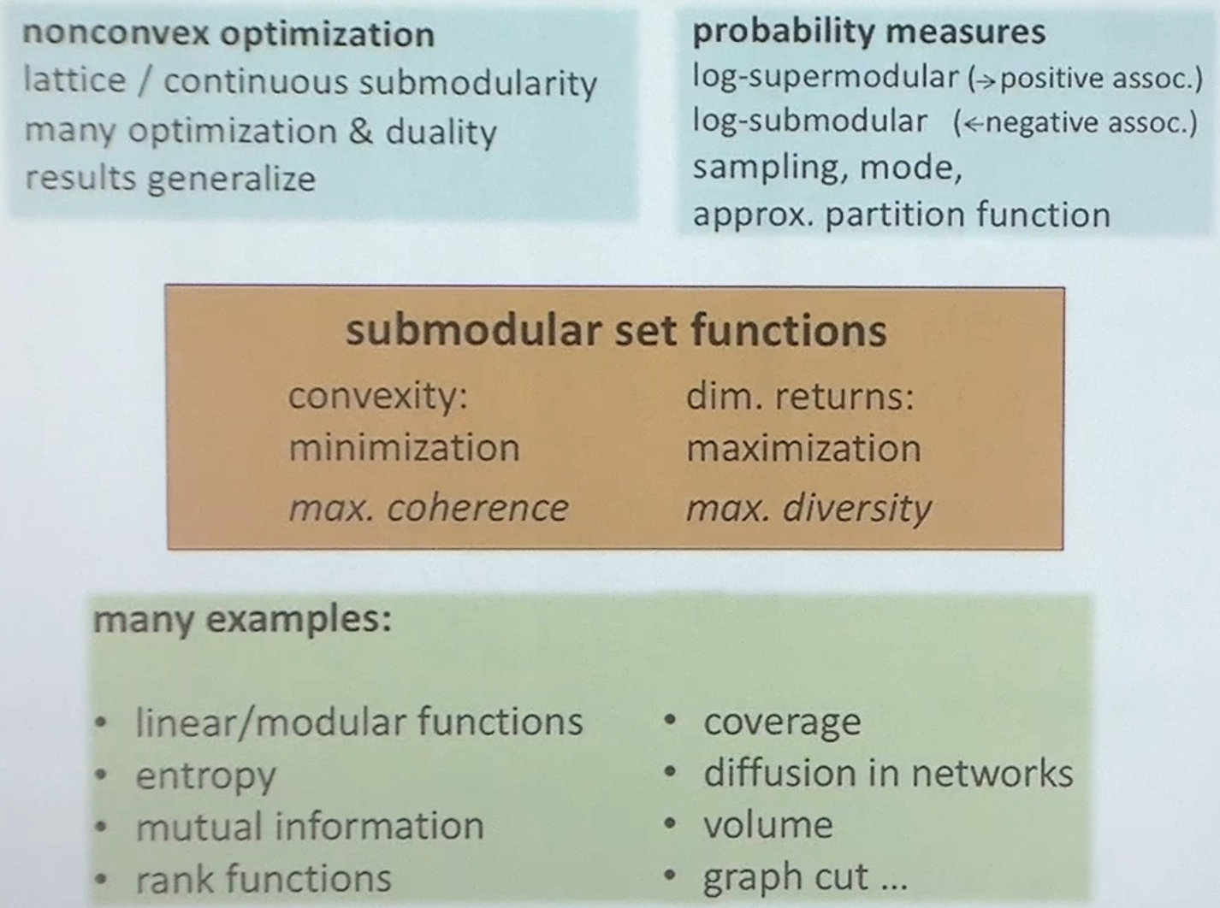

Slide 17
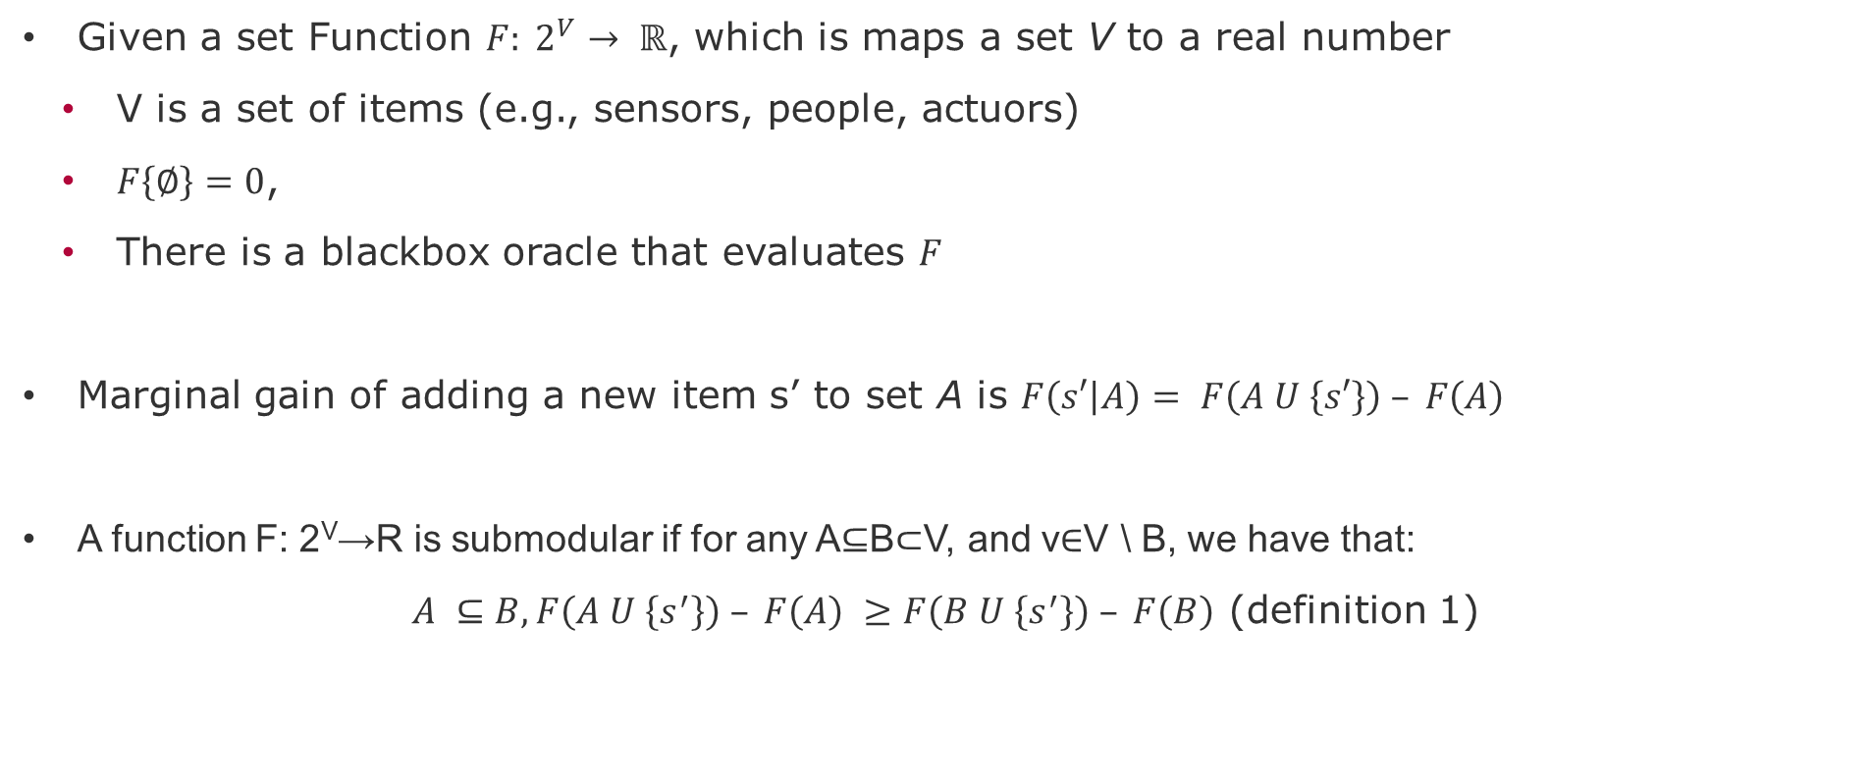
Submodular Set Function – Definition-1
Given a set Function $F: 2^{V}→ ℝ$, which is maps a set V to a real number
V is a set of items (e.g., sensors, people, actuors)
$F\left\{∅\right\}=0$,
There is a blackbox oracle that evaluates $F$
Marginal gain of adding a new item s’ to set A is $F\left(s′ | A\right)= F\left(A U \left\{s′\right\}\right) – F\left(A\right)$
A function F: 2^{V}→R is submodular if for any A⊆B⊂V, and v∈V \ B, we have that:
$A ⊆B, F\left(A U \left\{s^{′}\right\}\right) – F\left(A\right) ≥F\left(B U \left\{s^{′}\right\}\right) – F\left(B\right)$ (definition 1)
Notes:
Sources: Stefanie Jegelka, MIT, Submodularity: Theory and Applications I https://www.youtube.com/watch?v=Y3u_hvxayDY

Slide 18
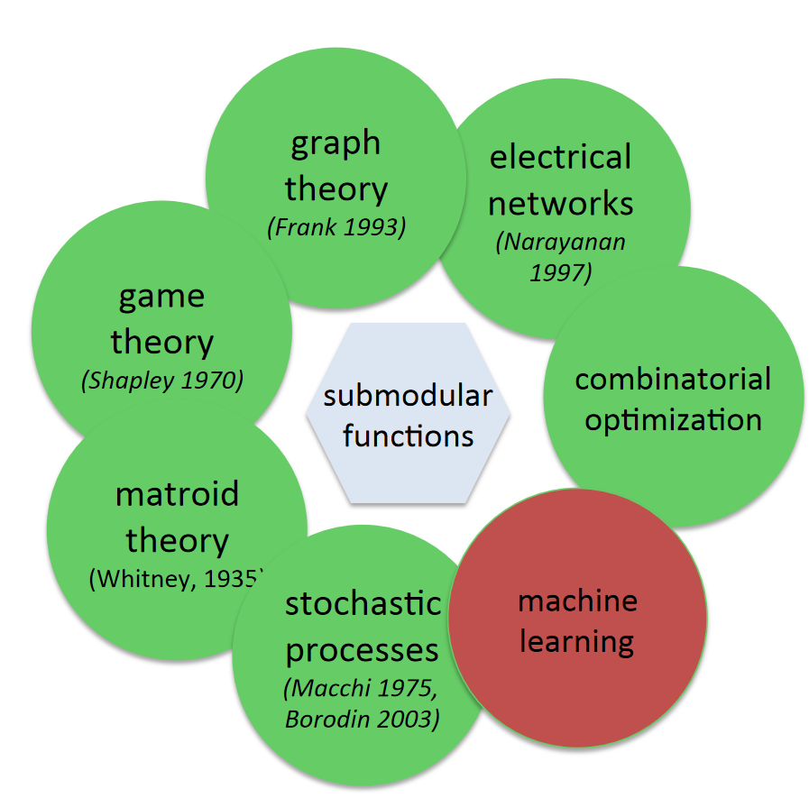
Short historical perspective of submodular functions
(70’s-90’s) Foundations of combinatorial optimization:[Edmonds, Lovász, Schrijver, Welsh,...]
Topics: rank functions of matroids, polymatroids, matroid intersection, submodular flows and minimization
Algorithms: submodular functions often appear in the background of P-time solvable problems.
(2000-now) Algorithmic game theory:[Lehmann, Nisan, Dobzinski, Papadimitriou, Kempe, Kleinberg, Tardos,...]
Topics: submodular functions to model valuation functions of agents with diminishing returns
Algorithms: algorithms and incentive-compatible mechanisms for problems like combinatorial auctions, cost sharing, and marketing on social networks.
(2005-now) Machine learning:[Guestrin, Krause, Gupta, Golovin, Bilmes,...]
Topics: submodular functions often appear as objective functions of machine learning tasks such as sensor placement, document summarization or active learning
Algorithms: Greedy, Local Search, Sketch
Update this https://youtu.be/Y3u_hvxayDY?t=1737
Vondrak, J., (2012), Submodular Functions and Their Applications, Discrete Math Conference, https://theory.stanford.edu/~jvondrak/data/SIDMA-plenary-talk.pdf
Liu, Y., et al., 2020, Submodular optimization problems and greedy strategies: A survey. Discrete Event Dynamic Systems: 1-32.
Notes:
Viral marketing [Kempe et al., 2003]
Network monitoring [Leskovec et al., 2007, Gomez Rodriguez et al., 2010]
Sensor placement and information gath-ering [Guestrin et al., 2005]
News article recommendation [El-Arini et al., 2009]
Nonparametriclearning [Reed and Ghahramani, 2013]
Document and corpus summarization [Lin and Bilmes,2011, Kirchhoff and Bilmes, 2014, Sipos et al., 2012]
Data summarization [Mirzasoleimanet al., 2013]
Crowd teaching [Singla et al., 2014]
MAP inference of “determinantal” point-process [Gillenwater et al., 2012]

Slide 19
Applications of submodular function optimization
Viral marketing [Kempe et al., 2003]
Network monitoring [Leskovec et al., 2007, Rodriguez et al., 2010]
Sensor placement and information gathering [Guestrin et al., 2005]
News article recommendation [El-Arini et al., 2009]
Non-parametric learning [Reed and Ghahramani, 2013]
Document and corpus summarization [Lin and Bilmes,2011, Kirchhoff and Bilmes, 2014, Sipos et al., 2012]
Data summarization [Mirzasoleimanet al., 2013]
Crowd teaching [Singla et al., 2014]
MAP inference of “determinantal” point-process [Gillenwater et al., 2012]
In many of these problems can be reduced to a problem of maximizing a submodular function that is subject to constraints like cardinality, knapsack, and intersection of matroids.
Feldman et al. (2017) Greed Is Good: Near-Optimal Submodular Maximization via Greedy Optimization
Notes:
From Feldman et al. (2017), Greed Is Good: Near-Optimal Submodular Maximization via Greedy Optimization
[Kempe et al., 2003] David Kempe, Jon Kleinberg, and ́Eva Tardos. Maximizing the spread of influence through asocial network. In KDD, 2003
[Leskovec et al., 2007] Jure Leskovec, Andreas Krause, Carlos Guestrin, Christos Faloutsos, Jeanne Van Briesen, andNatalie Glance. Cost-effective outbreak detection in networks. In KDD, 2007
[Rodriguez et al., 2010] Manuel Gomez Rodriguez, Jure Leskovec, and Andreas Krause. Inferring networks of diffusion and influence. In KDD, 2010
[Guestrin et al., 2005] Carlos Guestrin, Andreas Krause, and Ajit Paul Singh. Near-optimal sensor placements in gaussian processes. In ICML, 2005
[El-Arini et al., 2009] Khalid El-Arini, Gaurav Veda, Dafna Shahaf, and Carlos Guestrin. Turning down the noise in the blogosphere. In KDD, 2009
[Reed and Ghahramani, 2013] Colorado Reed and Zoubin Ghahramani. Scaling the indian buffet process via submodular maximization. In ICML, 2013
[Lin and Bilmes,2011] Hui Lin and Jeff Bilmes. A class of submodular functions for document summarization. In ACL, 2011
[Kirchhoff and Bilmes, 2014] Katrin Kirchhoff and Jeff Bilmes. Submodularity for data selection in statistical machine translation. In EMNLP, 2014
[Sipos et al., 2012] Ruben Sipos, Adith Swaminathan, Pannaga Shivaswamy, and Thorsten Joachims. Temporal corpus summarization using submodular word coverage. In CIKM, 2012
[Mirzasoleimanet al., 2013] Baharan Mirzasoleiman, Amin Karbasi, Rik Sarkar, and Andreas Krause. Distributed submodular maximization: Identifying representative elements in massive data. In NIPS, 2013.
[Singla et al., 2014] Adish Singla, Ilija Bogunovic, G ́abor Bart ́ok, Amin Karbasi, and Andreas Krause. Near-optimally teaching the crowd to classify. In ICML, 2014
[Gillenwater et al., 2012] Jennifer Gillenwater, Alex Kulesza, and Ben Taskar. Near-optimal MAP inference for determinantal point processes. In NIPS, 2012

Slide 20
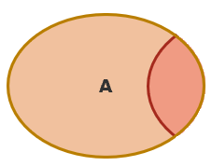
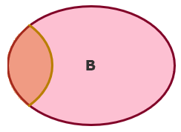


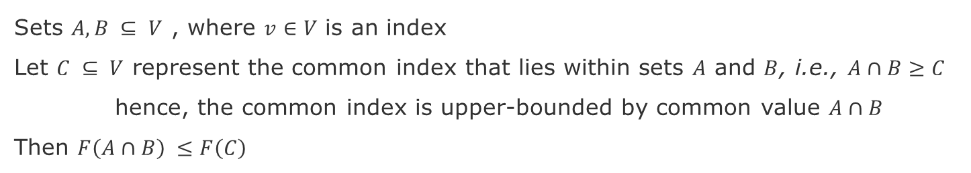


Submodularity as Information of a set [Bilmes 2020]
A function $F: 2V→R$is submodular if for any $A,B ⊆ V,$we have that
$F\left(A\right)+ F\left(B\right)≥F\left(A∪B\right)+F\left(A∩B\right)$ (definition 2)
Sets $A,B ⊆ V$ , where $v∈V$ is an index
Let $C ⊆ V$ represent the common index that lies within sets $A$ and $B$, i.e., $A∩B≥C$
hence, the common index is upper-bounded by common value $A∩B$
Then $F\left(A∩B\right) ≤F\left(C\right)$
A
B
C
$$F\left(A\right)+ F\left(B\right) ≥ F\left(A∪B\right) + F\left(A∩B\right)$$
$$F\left(A_{r}\right)+2F\left(C\right)+ F\left(B_{r}\right)$$
$$F\left(A_{r}\right)+F\left(C\right)+ F\left(B_{r}\right)$$
$$F\left(A∩B\right)$$
A
B
A
B
C
$$2F\left(C\right)≥F\left(C\right)+F\left(A∩B\right)$$
$$F\left(C\right)≥F\left(A∩B\right)$$
source: [Bilmes 2020] J. Bilmes, EE563 - Submodular Functions, Optimization, and Applications to Machine Learning, Fall Quarter, 2020, https://people.ece.uw.edu/bilmes/classes/ee563/ee563_fall_2020/
Notes:
J. Bilmes, EE563 - Submodular Functions, Optimization, and Applications to Machine Learning, Fall Quarter, 2020
https://people.ece.uw.edu/bilmes/classes/ee563/ee563_fall_2020/

Slide 21



Submodularity as Information of a set [Bilmes 2020]
What happens when we have disjoint classes? i.e., $F\left(A∩B\right)=∅$
A
B
$$F\left(A\right)+ F\left(B\right) ≥ F\left(A∪B\right) + F\left(A∩B\right)$$
$$F\left(A_{r}\right)+ F\left(B_{r}\right)$$
$$F\left(A_{r}\right)+ F\left(B_{r}\right)$$
$$∅$$
A
B
A
B
$$F\left(A\right)+ F\left(B\right) = F\left(A∪B\right) + F\left(A∩B\right)$$

Slide 22
Examples of submodular functions
Entropy
Ranking
Graph cut
Knap sack
Matching
Markov random field https://youtu.be/Y3u_hvxayDY?t=1427

Slide 23
Further topics on submodular optimization
Adaptive Submodularity: optimization problems with partially observable states [Goloviv & Krause 2011]
Golovin, D., and A. Krause, (2011) Adaptive submodularity: theory and applications in active learning and stochastic optimization. J Artif Intell Res.
Notes:
Golovin, D., and A. Krause, 2001: Adaptive submodularity: theory and applications
in active learning and stochastic optimization. J Artif Intell Res,
42, 427{486.

Slide 24
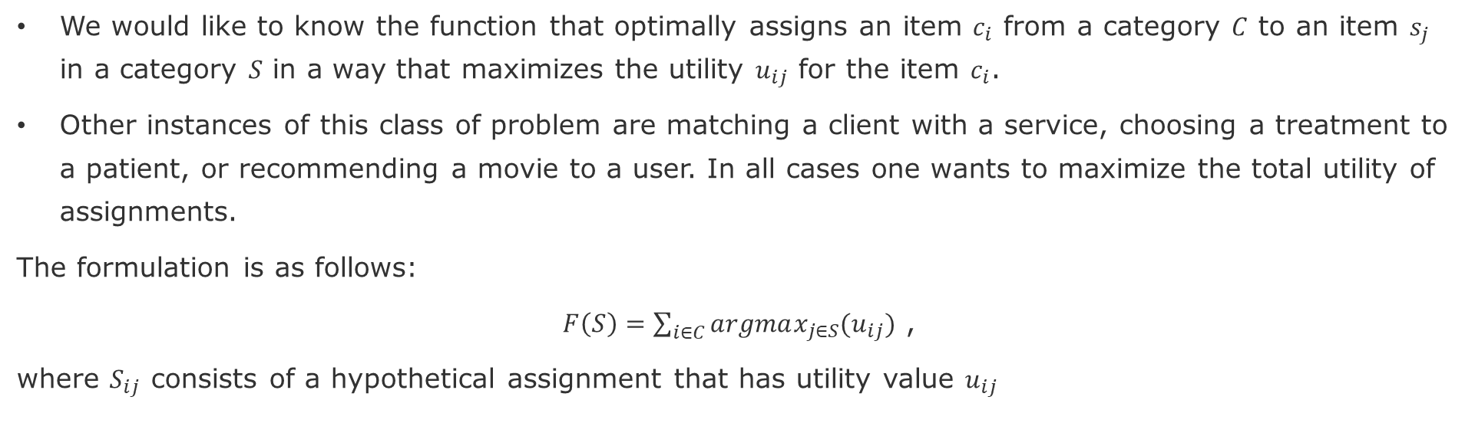
Example: Optimal Assignment Problem
We would like to know the function that optimally assigns an item $c_{i}$ from a category $C$ to an item $s_{j}$ in a category $S$ in a way that maximizes the utility $u_{ij}$ for the item $c_{i}$.
Other instances of this class of problem are matching a client with a service, choosing a treatment to a patient, or recommending a movie to a user. In all cases one wants to maximize the total utility of assignments.
The formulation is as follows:
$F\left(S\right)=\sum_{i∈C}{argmax_{j∈S}(u_{ij})}$ ,
where $S_{ij}$ consists of a hypothetical assignment that has utility value $u_{ij}$
Is this function submodular?
Notes:
This assignment is an injective function, because $c_{i}$can be assigned only once, but each multiple $c_{i}$ can be assigned to the same item $s_{j}$, whereas the reverse is not true.

Slide 25
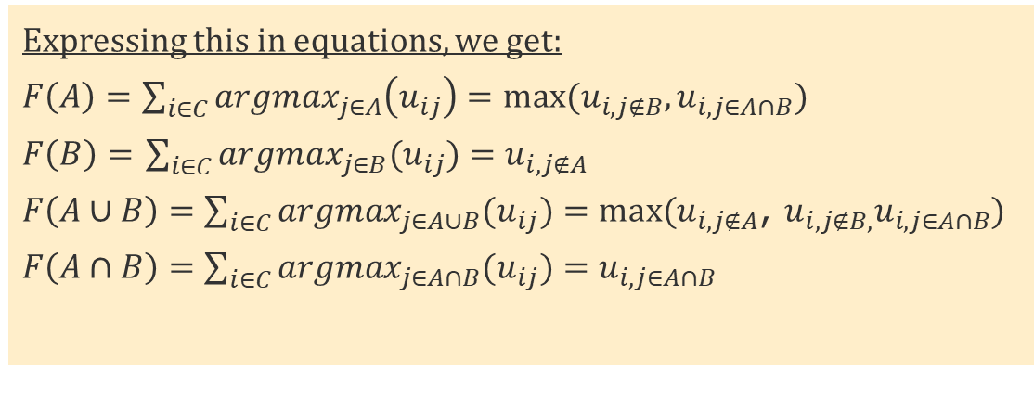
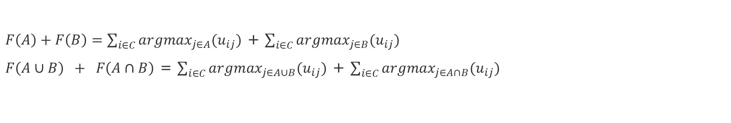



Proof of Submodularity
$F\left(A\right)+F\left(B\right)=\sum_{i∈C}{argmax_{j∈A}(u_{ij})}$ + $\sum_{i∈C}{argmax_{j∈B}(u_{ij})}$
$F\left(A∪B\right) + F\left(A∩B\right)$ = $\sum_{i∈C}{argmax_{j∈A∪B}(u_{ij})}$ + $\sum_{i∈C}{argmax_{j∈A∩B}(u_{ij})}$
Intuition of the proof: look the possible combinations of choices of services contained in A, B, or both.
A
B
Expressing this in equations, we get:
$F\left(A\right)=\sum_{i∈C}{argmax_{j∈A}\left(u_{ij}\right)=max⁡(u_{i,j∉B},}u_{i,j∈A∩B})$
$F\left(B\right)=$ $\sum_{i∈C}{argmax_{j∈B}(u_{ij})}=u_{i,j∉A}$
$F\left(A∪B\right)=\sum_{i∈C}{argmax_{j∈A∪B}(u_{ij})}=max(u_{i,j∉A}$, $u_{i,j∉B,}u_{i,j∈A∩B})$
$F\left(A∩B\right)=\sum_{i∈C}{argmax_{j∈A∩B}(u_{ij})}=u_{i,j∈A∩B}$
$$u_{i,j∉B}$$
service in A, that is not in B
$$u_{i,j∉A}$$
service in B, that is not in A
$$u_{i,j∈A∩B}$$
service in A, that is also in B

Slide 26


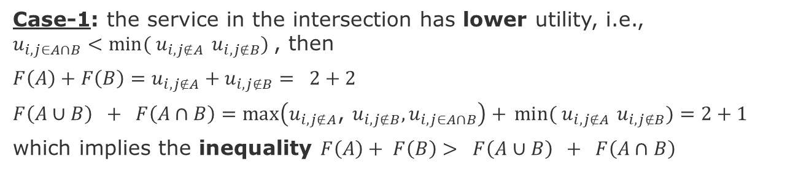
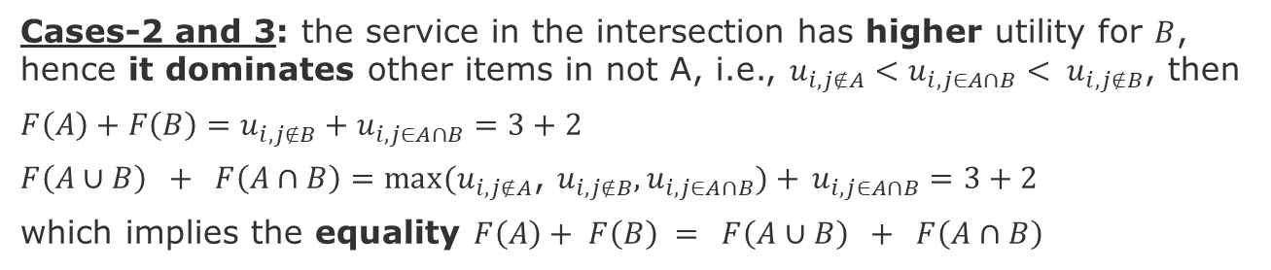


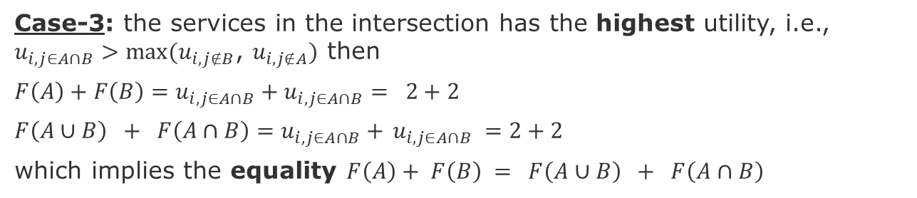





Four cases - Proof of Submodularity
A
B
Case-1: the service in the intersection has lower utility, i.e., ${u_{i,j∈A∩B}<min⁡( u}_{i,j∉A}$ $u_{i,j∉B})$, then
$F\left(A\right)+F\left(B\right)=u_{i,j∉A}+u_{i,j∉B}= 2+2$
$F\left(A∪B\right) + F\left(A∩B\right)=max\left(u_{i,j∉A}\text{, }u_{i,j∉B},u_{i,j∈A∩B}\right)+$ ${min⁡( u}_{i,j∉A}$ $u_{i,j∉B})=2+1$
which implies the inequality $F\left(A\right)+ F\left(B\right)> F\left(A∪B\right) + F\left(A∩B\right)$
$u_{i,j∉B}$=2
$u_{i,j∈A∩B}$=1
$$u_{i,j∉A}=2$$
A
B
Cases-2 and 3: the service in the intersection has higher utility for $B$, hence it dominates other items in not A, i.e., ${u_{i,j∉A}<u_{i,j∈A∩B}< u}_{i,j∉B}$, then
$F\left(A\right)+F\left(B\right)=u_{i,j∉B}+u_{i,j∈A∩B}=3+2$
$F\left(A∪B\right) + F\left(A∩B\right)=max(u_{i,j∉A}\text{, }u_{i,j∉B},u_{i,j∈A∩B})+$ $u_{i,j∈A∩B}=3+2$
which implies the equality $F\left(A\right)+ F\left(B\right) = F\left(A∪B\right) + F\left(A∩B\right)$
$u_{i,j∉B}$=3
$u_{i,j∈A∩B}$=2
$$u_{i,j∉A}=1$$
A
B
Case-3: the services in the intersection has the highest utility, i.e., ${u_{i,j∈A∩B}>max⁡(u}_{i,j∉B}$, $u_{i,j∉A})$ then
$F\left(A\right)+F\left(B\right)=u_{i,j∈A∩B}+u_{i,j∈A∩B}= 2+2$
$F\left(A∪B\right) + F\left(A∩B\right)=u_{i,j∈A∩B}+$ $u_{i,j∈A∩B} =2+2$
which implies the equality $F\left(A\right)+ F\left(B\right) = F\left(A∪B\right) + F\left(A∩B\right)$
$u_{i,j∉B}$=1
$u_{i,j∈A∩B}$=2
$$u_{i,j∉A}=1$$
Notes:
In case-2: the service in the intersection is chosen for B. It however has to have lower value than the one chosen for the not B.

Slide 27
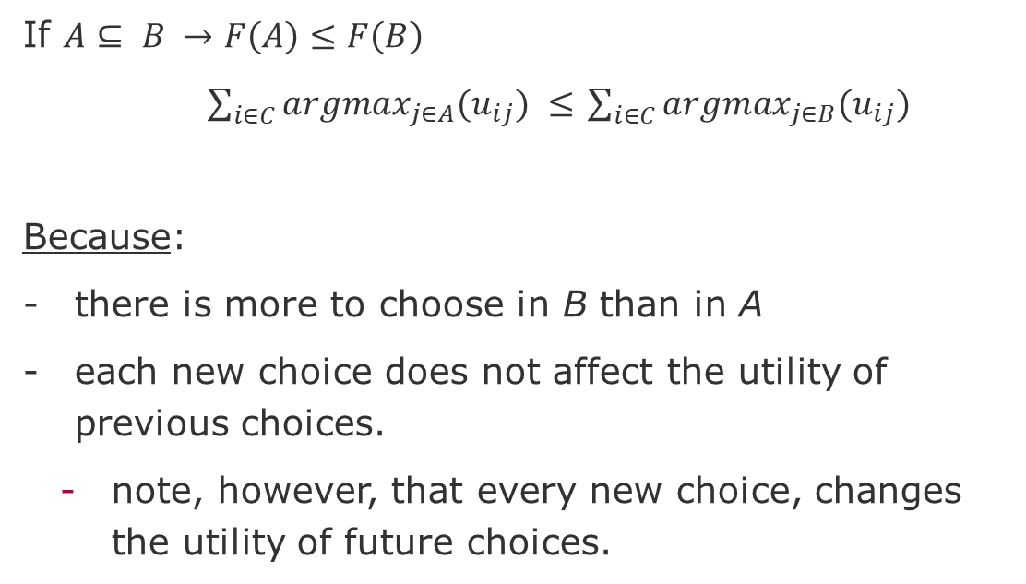


Non-Decreasing - Monotone
If $A⊆ B →F\left(A\right)≤F\left(B\right)$
$\sum_{i∈C}{argmax_{j∈A}(u_{ij}) }≤$ $\sum_{i∈C}{argmax_{j∈B}(u_{ij}) }$
Because:
there is more to choose in B than in A
each new choice does not affect the utility of previous choices.
note, however, that every new choice, changes the utility of future choices.
B
A
$u_{i,j∈A∩B}$== $u_{i,j∉B}$
$$u_{i,j∉A}$$

Slide 28
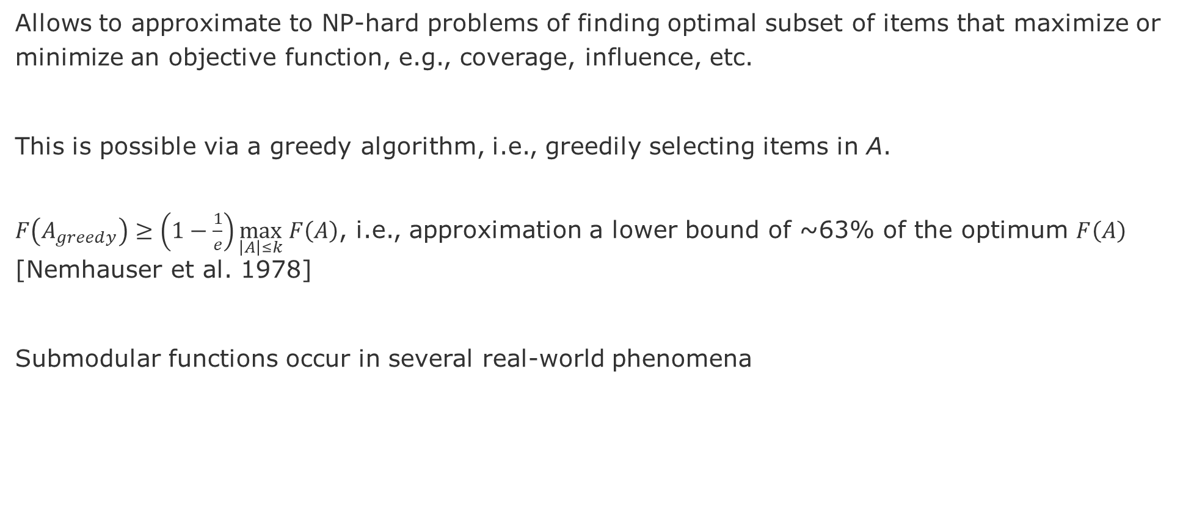
Why is submodularity important?
Allows to approximate to NP-hard problems of finding optimal subset of items that maximize or minimize an objective function, e.g., coverage, influence, etc.
This is possible via a greedy algorithm, i.e., greedily selecting items in A.
$F\left(A_{greedy}\right)≥\left(1−\frac{1}{e}\right)\max_{\left|A\right|≤k} F\left(A\right)$, i.e., approximation a lower bound of ~63% of the optimum $F\left(A\right)$ [Nemhauser et al. 1978]
Submodular functions occur in several real-world phenomena
Nemhauser, G. L., Wolsey, L. A., & Fisher, M. L. (1978). An analysis of approximations for maximizing submodular set functions—I. Mathematical programming, 14(1), 265-294.

Slide 29
Influence Maximization
Submodular functions occur in several real-world phenomena

Slide 30
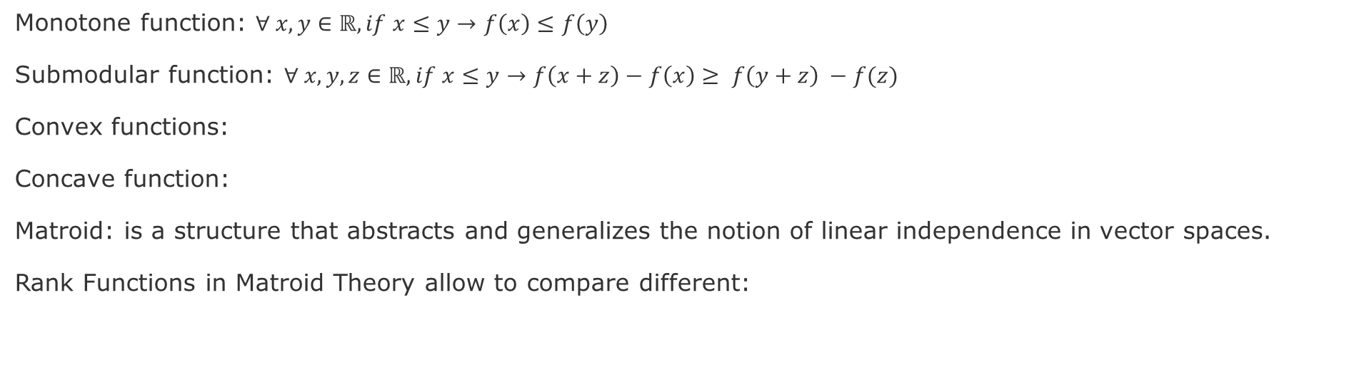
Concepts
Monotone function: $∀ x, y∈ℝ, if x≤y→f\left(x\right)≤f\left(y\right)$
Submodular function: $∀ x,y,z∈ℝ, if x≤y→f\left(x+z\right)−f\left(x\right)≥ f\left(y+z\right) −f(z)$
Convex functions:
Concave function:
Matroid: is a structure that abstracts and generalizes the notion of linear independence in vector spaces.
Rank Functions in Matroid Theory allow to compare different:
Notes:
From Wikipedia: “Matroid theory borrows extensively from the terminology of linear algebra and graph theory, largely because it is the abstraction of various notions of central importance in these fields. Matroids have found applications in geometry, topology, combinatorial optimization, network theory and coding theory “

